Slide 1
Project 1
Rachel Weber
Fall 2018

Slide 2
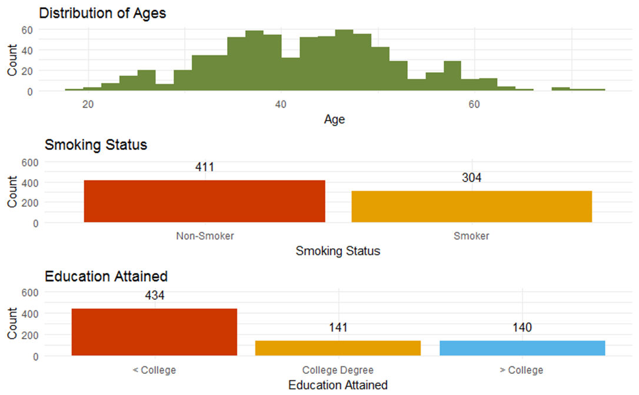
Background
The Data:
Prospective study on natural and treated histories of HIV-1 infected men with up to 8 years of data both from lab tests and quality of life assessments
Subjects were seen annually after beginning HAART
After data cleaning 474 patients remained, all of which had complete lab test data. 468 had complete QOL data
Question of Interest:
How does treatment response differ from year 0 to year 2 between patients who report hard drug use at baseline and those who do not?
Hypothesis:
Drug users may have poor treatment response necessitating more aggressive treatment strategies or enrollment in drug rehabilitation programs
Notes:
Which was motivated by mixed evidence as to whether or nor hard drug use negatively impacted human immune systems

Slide 3
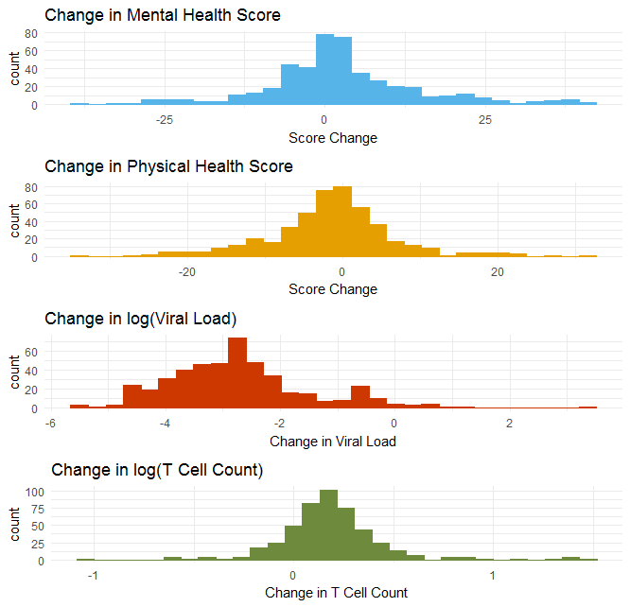
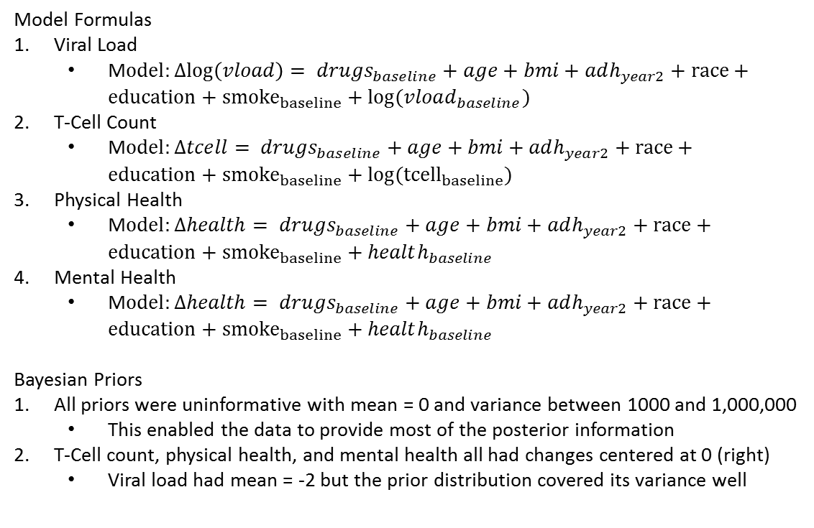
Analysis Plan
Model Formulas
Viral Load
M$odel:Δlog\left(vload\right)= drugs_{baseline}+age+bmi+adh_{year2}+race+education+{smoke}_{baseline}+log⁡(vload_{baseline})$
T-Cell Count
M$odel:Δtcell= drugs_{baseline}+age+bmi+adh_{year2}+race+education+{smoke}_{baseline}+{log(tcell}_{baseline})$
Physical Health
M$odel:Δhealth= drugs_{baseline}+age+bmi+adh_{year2}+race+education+{smoke}_{baseline}+health_{baseline}$
Mental Health
M$odel:Δhealth= drugs_{baseline}+age+bmi+adh_{year2}+race+education+{smoke}_{baseline}+health_{baseline}$
Bayesian Priors
All priors were uninformative with mean = 0 and variance between 1000 and 1,000,000
This enabled the data to provide most of the posterior information
T-Cell count, physical health, and mental health all had changes centered at 0 (right)
Viral load had mean = -2 but the prior distribution covered its variance well

Slide 4
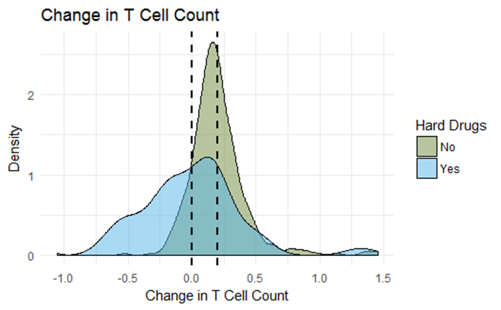
Results - CD4+ Count
Average change: 1.354 log unit
Average for drug users: 1.14 log units
95% CI: 1.074-1.204
Frequentist and Bayesian models agreed almost perfectly
Conclusion:
Hard Drug use decreases the CD4+ count improvement seen in patients over 2 years of participation in the HAART regimen.

Slide 5
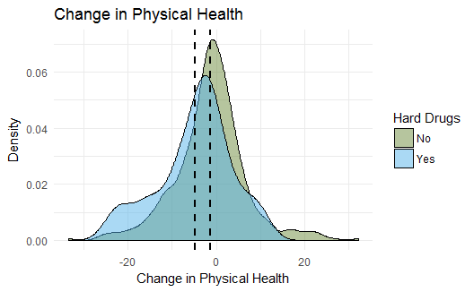
Results - Physical Health
Average change: 17 point increase
Average for drug users: 13.45
95% CI: 10.64-16.26
Frequentist and Bayesian models agreed almost perfectly
Conclusion:
Hard Drug use decreases the Amount of Physical improvement seen in patients over 2 years of participation in the HAART regimen.

Slide 6
Takeaways
No Impact:
Mental Health Quality of Life
Diminishment of Viral Load
Negative Impact:
Physical Health Quality of Life – 4 point decrease
T Cell Count Improvement – .2 log units
The analysis was hindered by many patients lost to follow-up by year two (241) and model ignorance of data at year one
Analysis in a longitudinal framework could take advantage of repeated measures over 8 years and better estimate the effects of hard drug use

